Slide 1
Practical Information Security Practices – Boot Camp Risk Assessment

Slide 2
Starting Point
Where is the starting point for a Security review or audit ?
Need a logical approach ?
Which area do you review first ?

Slide 3
Why a Risk Assessment ?
To identify key area’s assets that may be vulnerable
There are many types:
Operational
Financial
Audit
Security

Slide 4
A Practical Approach
Identify all your Assets.
Identify the Threats and Vulnerabilities.
Determine the Impact.
Calculate the Risk.

Slide 5
What is an Asset ?
Definitions of asset (n)
as·set [ á sèt ]
somebody or something useful: somebody or something that is useful and contributes to the success of something
valuable thing: a property to which a value can be assigned
owned items: the property that is owned by a person or organization

Slide 6
Threats and Vulnerabilities
Lets List Some Potential Threats and Vulnerabilities:

Slide 7
Areas of Risk
Integrity
Availability
Confidentiality
Operational
Financial
Depending on your objectives you may have other types of Risk that may have

Slide 8
Determine the Impact
What is the effect that the threat or vulnerability will have on the organization if it happens ?
Items to consider
Measurable
Dollar Impact
Reputation
Assign a impact rating or value

Slide 9
Calculate the Risk
Many Techniques for Risk Calculation.
Use the one that is simple and meets your immediate requirements.

Slide 10
Risk Formula
RISK = Initial Sensitivity * (Impact of Threats * Probability of Occurrence)
Rank of = Asset – Value of 1 to 5 with 1 the lowest and 5 being the highest in in importance to the organization.
Threats = Threats are Ranked on a 1 to 5 basis with 5 being the most destructive to the organization
Probability = The chance of a particular threat occurring.

Slide 11
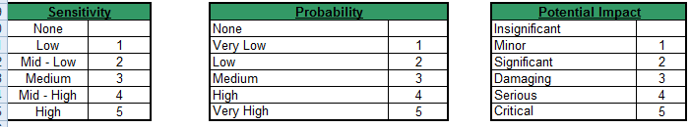
Example Risk Scoring

Slide 12
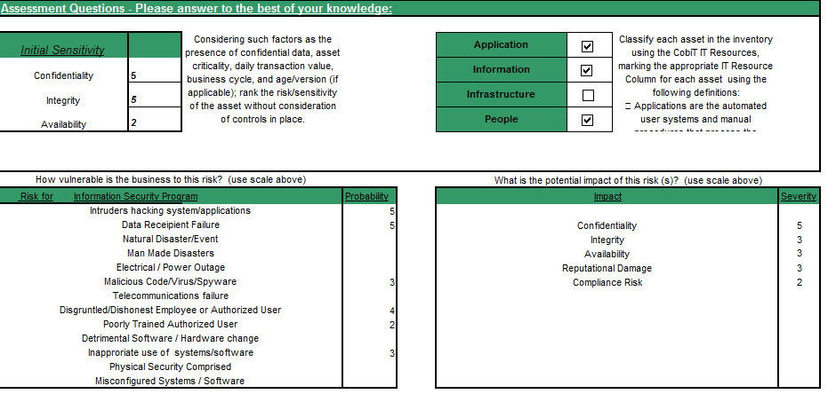
Example Risk Scoring

Slide 13
Example Risk Scoring
How vulnerable is the business to this risk? (use scale above) |  |  |  |  |  | What is the potential impact of this risk (s)? (use scale above)
Risk for | Information Security Program |  |  | Probability |  | Impact |  |  |  |  | Severity
Intruders hacking system/applications |  |  |  | 5
Data Receipient Failure |  |  |  | 5 |  | Confidentiality |  |  |  |  | 5
Natural Disaster/Event |  |  |  |  |  | Integrity |  |  |  |  | 3
Man Made Disasters |  |  |  |  |  | Availability |  |  |  |  | 3
Electrical / Power Outage |  |  |  |  |  | Reputational Damage |  |  |  |  | 3
Malicious Code/Virus/Spyware |  |  |  | 3 |  | Compliance Risk |  |  |  |  | 2
Telecommunications failure
Disgruntled/Dishonest Employee or Authorized User |  |  |  | 4
Poorly Trained Authorized User |  |  |  | 2
Detrimental Software / Hardware change
Inapproriate use of systems/software |  |  |  | 3
Physical Security Comprised
Misconfigured Systems / Software
Initial Rsk
Confidentiaity Risk |  | 4.14
Integrity Risk |  | 4.14
Availability Risk |  | 2.62
Overall Risk |  | 3.63
Example Threats/ Vulnerabilities/Issues |  |  |  |  |  | Example Preventative Measures
Unauthorized Access to Data |  |  |  |  |  | Development of Security Policies and Procedures
Failure to Comply of with various regulations on Privacy |  |  |  |  |  | Execution of IT Risk Assessement

Slide 14
Risk Rank the Assets
Area |  | Confidentiality | Integrity | Availability | Total Risk Score
Vendor Management |  | 1.36 | 1.36 | 1.36 | 1.36
IT Governance |  | 2.21 | 2.21 | 1.11 | 1.84
Human Resources' |  | 3.00 | 2.69 | 1.34 | 2.34
Networking - External |  | 2.10 | 2.10 | 2.97 | 2.39
Third Party Providers |  | 2.08 | 2.55 | 2.55 | 2.40
IT Disaster Recovery |  | 1.74 | 1.74 | 3.89 | 2.46
Computer Operations |  | 2.87 | 2.87 | 2.87 | 2.87
Co_locations Facility |  | 2.89 | 2.89 | 3.24 | 3.01
Physical Security |  | 2.93 | 2.93 | 3.38 | 3.08
end-user computing |  | 3.22 | 2.63 | 3.72 | 3.19
Backup and Recovery |  | 2.78 | 3.58 | 3.58 | 3.31
Networking Internal |  | 3.40 | 3.40 | 3.80 | 3.54
On-line Banking - FIServe |  | 3.58 | 3.58 | 3.58 | 3.58
Change Control |  | 3.61 | 3.61 | 3.61 | 3.61
Information Security Program |  | 4.14 | 4.14 | 2.62 | 3.63
Logical Security |  | 3.98 | 3.98 | 3.98 | 3.98
Virus Protection |  | 4.53 | 4.53 | 4.53 | 4.53
Internal Servers |  | 3.08 | 3.08 | 3.55 | 3.23
Internal Applications |  | 3.06 | 3.06 | 3.06 | 3.06

Slide 15
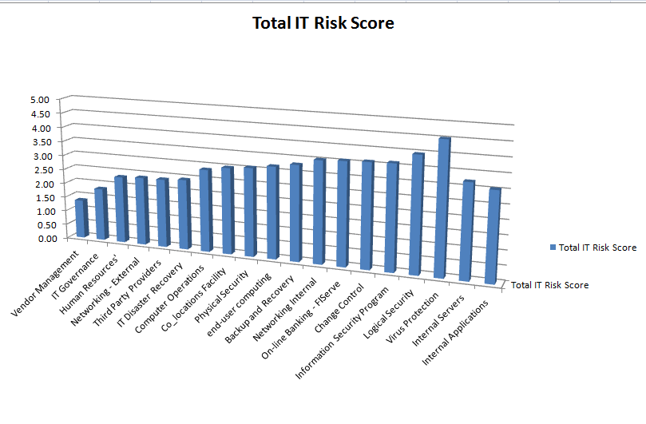
Total Risk Score

Slide 16
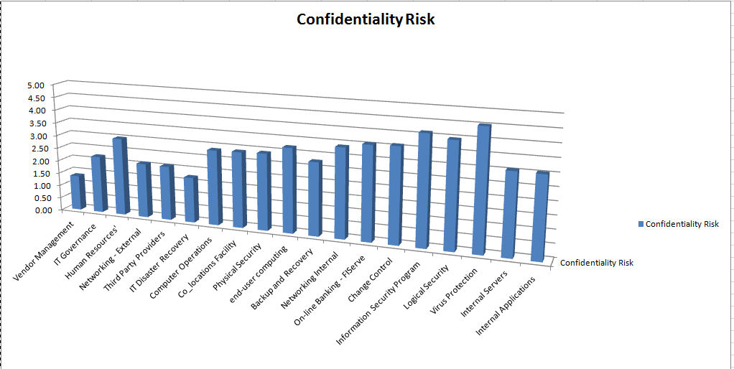
Confidentiality Risk

Slide 17
Recap
1. Identify and Inventory the Assets
2. Determine the Initial Value
3. Determine the Threats and Vulnerabilities
4. Calculate the Risk
5. Risk Rank and Determine what your going to review or audit.

Slide 18
Lab 1
Open example 2 – Lab
The CIO of ULM has asked you to completed an IT Security Risk Assessment . He would like you help him determine what the potential impact of Threats and Vulnerabilities which his team has already identified for the following areas:
ULM Internal Network
Logical Security
Student Records

